Slide 1
Lesson Zero
TOPICS: OPENING ALICE, SAVING YOUR WORLD, AND LOCATE THE INITIAL CAMERA POSITION
Notes:
NOTE: Before starting, make sure that the default template for each world template includes an “initialCamera” dummy object.

Slide 2
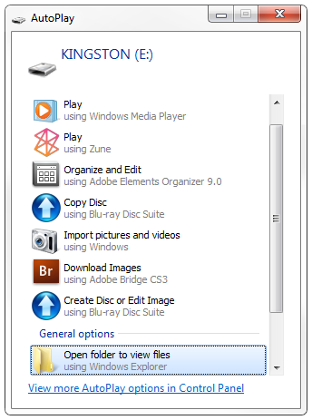
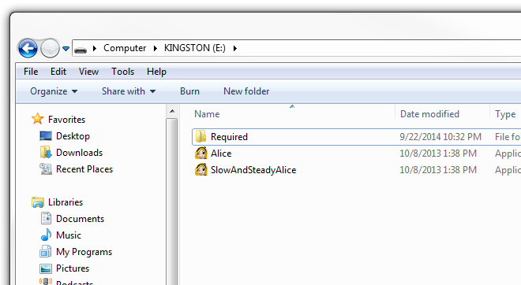
Step 1: Opening the Folder Containing Alice
Two Methods for Opening Alice (First Method):
Plug the USB drive into the Computer
After plugging in the USB drive, an Autoplay Window will open. Click on the "open folder to view files" button.
A folder for the USB drive will open on your screen. Find the Alice executable.

Slide 3
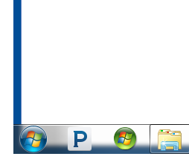
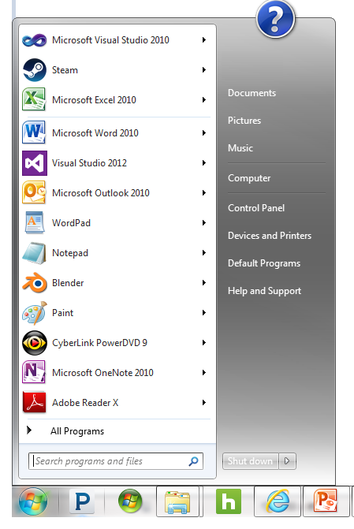
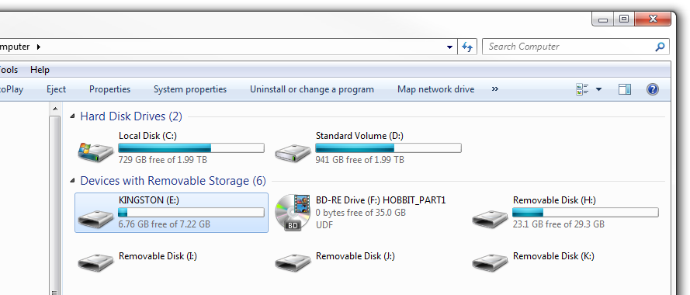
Step 1: Opening the Folder Containing Alice
Two Methods for Opening Alice (Second Method):
Plug the USB drive into the Computer
Find your task bar. Click on the start button on your task bar.
Click on the "Computer" button on the left
Find and click on the E drive to open the E drive in a new folder.
Find the Alice executable, as in the first method.
Notes:
NOTE: The task bar can be on the top, bottom, left, or right side of the screen. It may also be hidden. If it is hidden, then you will need to move the mouse over the appropriate part of the screen for the taskbar to become visible.

Slide 4
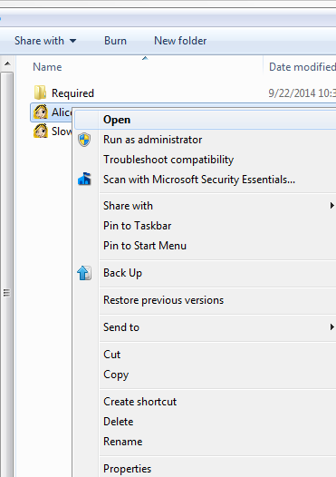
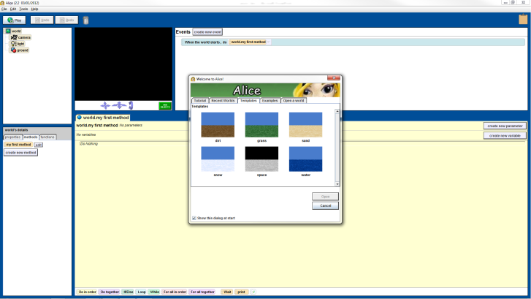
Step 2: Open Alice
To open Alice, just double click on the icon for the Alice program using the left mouse button. Alternatively, right click on the Alice executable once, and then left click on the “Open” button in the pop-up menu.
Notes:
The Alice program is an Integrated Development Environment (IDE) that programs can use to develop and run video games, movies, and other animation related creations.
For now, just ask the students to click on the Cancel button on the Alice welcome dialogue.

Slide 5
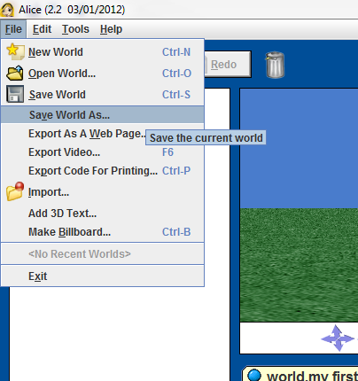
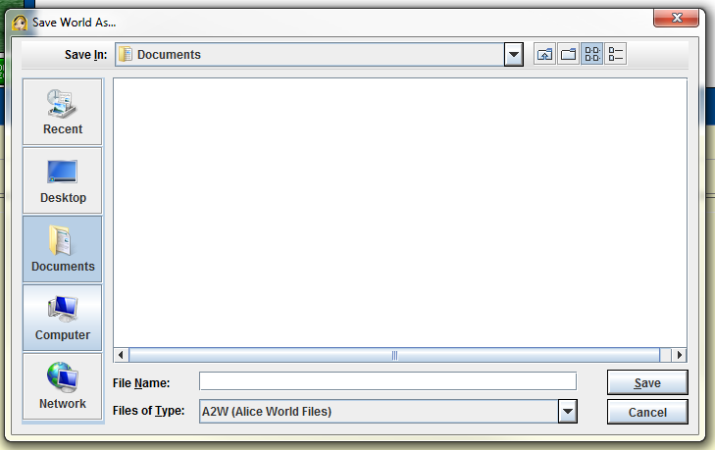
Step 3: Save Your World, Part I
Find the “File” menu option in the top left corner of the Alice program menu.
Left click on the “File” menu option.
Find the "Save world As“ option under the “File” menu.
Click on the “Save world As” option. This will open the “Save world as” dialogue window.
Find the "computer“ folder on the far left side of the “Save World as” dialogue window.
Find the “File” menu option in the top left corner of the Alice program menu.

Slide 6
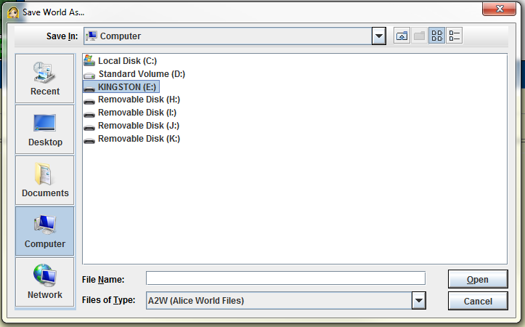
Step 3: Save Your World, Part II
Find the “E” drive in the “computer” folder.
Open the “E” drive by
Double clicking on the “E” drive with the left mouse button, or
Clicking once on the “E” drive with the left mouse button, and then clicking on the “Open” button on the lower right side of the “Save World as” dialogue.

Slide 7
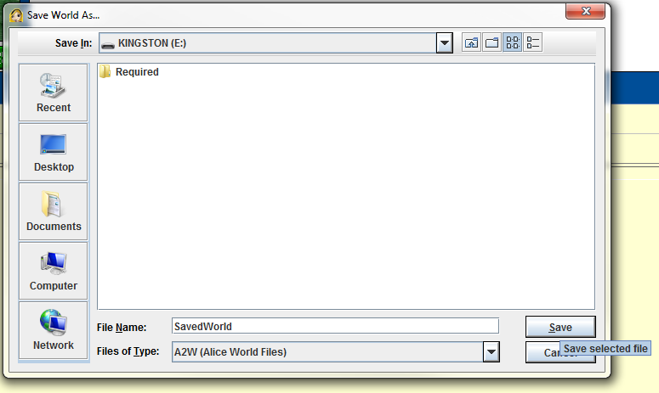
Step 3: Save Your World, Part III
Type the name of your world I the “File Name” field.
To now save your world you can either press the “Enter” button on your keyboard or click on the “Save” button on the lower right side of the “Save World as” dialogue window.

Slide 8
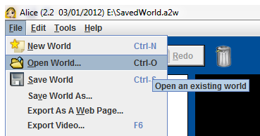
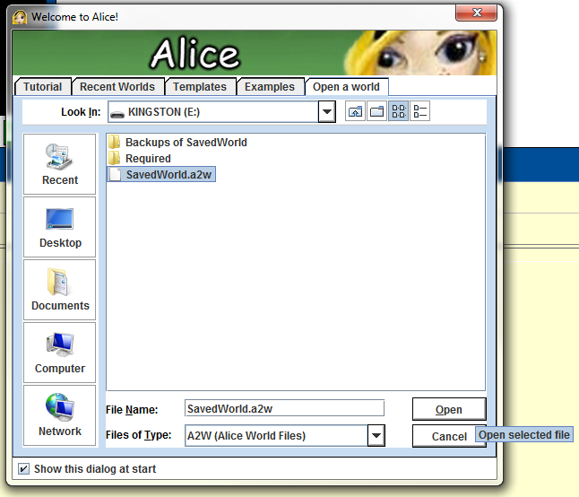
Step 4: Open a Saved World
To open a saved world, find the “File” menu option as in Step 3. Under the “File” menu option, fine the “Open World” option.
Select the “Open World option as we did for the “Save World As” option in Step 3, part I. This will open the “Welcome to Alice!” dialogue.
From within the “Welcome to Alice!” dialogue, navigate to the folder that contains the Alice world that you wish to open in the same manner as you did in Step 3 to save your Alice world. (Note: the most likely location of your Alice world is under the “E” drive.)
To open your Alice world, either double click on in in the “Welcome to Alice!” dialogue, or select it under the “Welcome to Alice!” dialogue and then click on the “Open” button on the same dialogue.
Notes:
Always encourage the students to save their Alice worlds directly under the “E” drive.

Slide 9
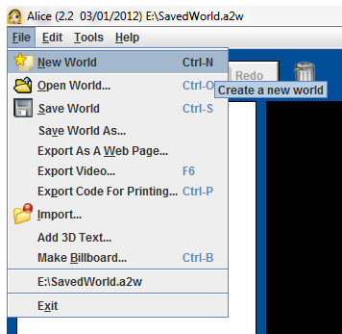
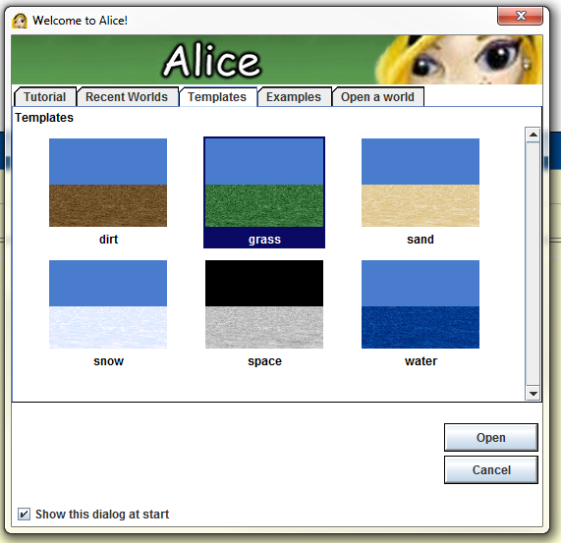
Step 5: Create a New World
To create a new world, Find the “File” menu option as in Step 3. Under the “File” menu option, fine the “New World” option.
Select the “New World option as we did for the “Save World As” option in Step 3, part I. This will open the “Welcome to Alice!” dialogue.
Select one of the six world templates {dirt, grass, sand, snow, space, or water} by left clicking on it, and then left click on the “Open” button.

Slide 10
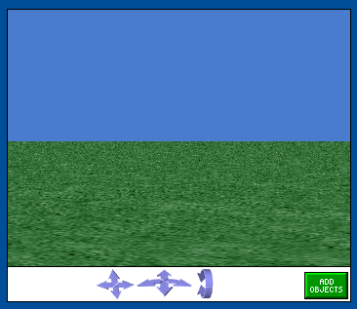
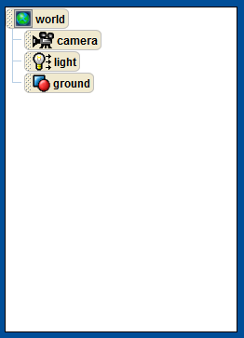
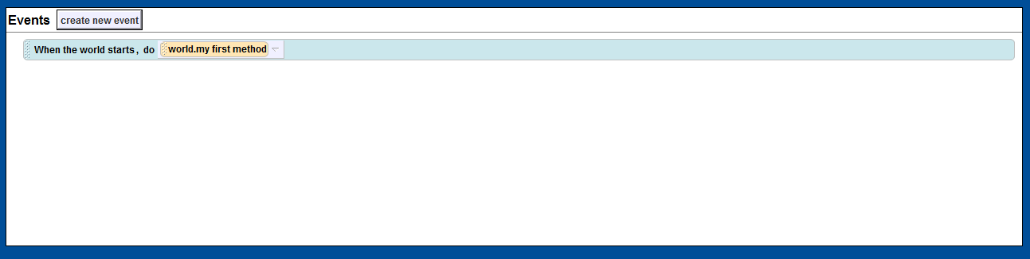
Step 6: Parts of the Alice World
Look at the “World Window.” The world view provides a perspective view into the Alice world that you are creating.
Look at the “Object Tree.” The object tree contains a tree-list of all of the objects in your Alice world
Look at the “Events Area.” The events area allows you to both see the events that your Alice world will respond to and enables you to add new event conditions for your Alice world to respond to.

Slide 11
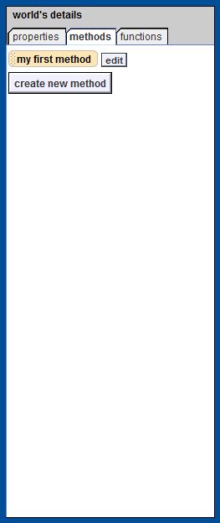
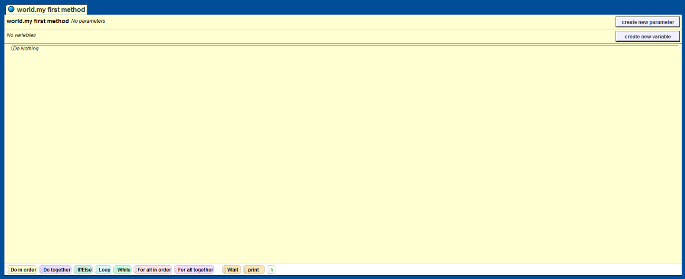
Step 6: Parts of the Alice World
Look at the “Detail’s Window.” The details window contains three tabs: a “properties” tab, which lists the properties for the selected Alice object; the “methods” tab, which lists the methods accessible for the currently selected Alice object; and the “functions” tab, which lists the functions accessible for the currently selected Alice object.
Look at the “Code Editor.” The code editor allows you to see and edit the code that drives an Alice function or method.

Slide 12
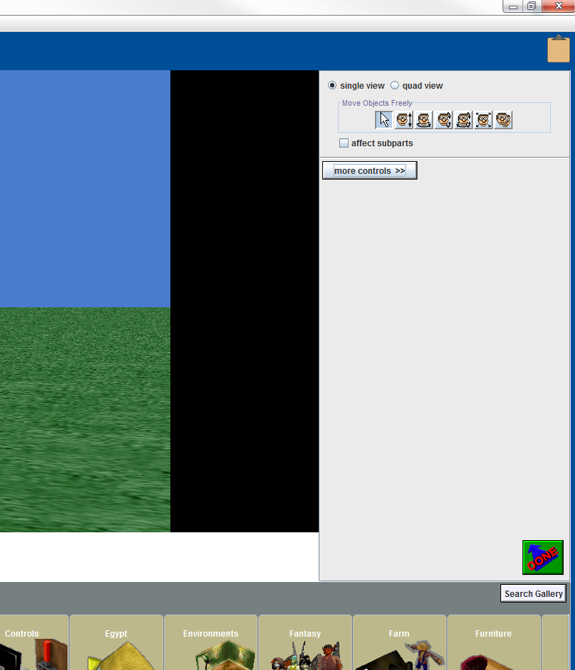
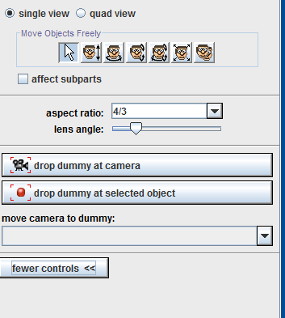
Step 7: Add a Dummy Object to the World
Click on the “ADD OBJECTS” button at the bottom right corner of the world view. This opens the Object Gallery.
Click on the “more controls >>” button at the far upper right corner of the screen.
Click on the “drop dummy at camera” from the set of hidden controls.

Slide 13
Activity Time!
Notes:
Show the students how to move around the world using the arrow keys and have them use the arrow keys in their own worlds.

Slide 14
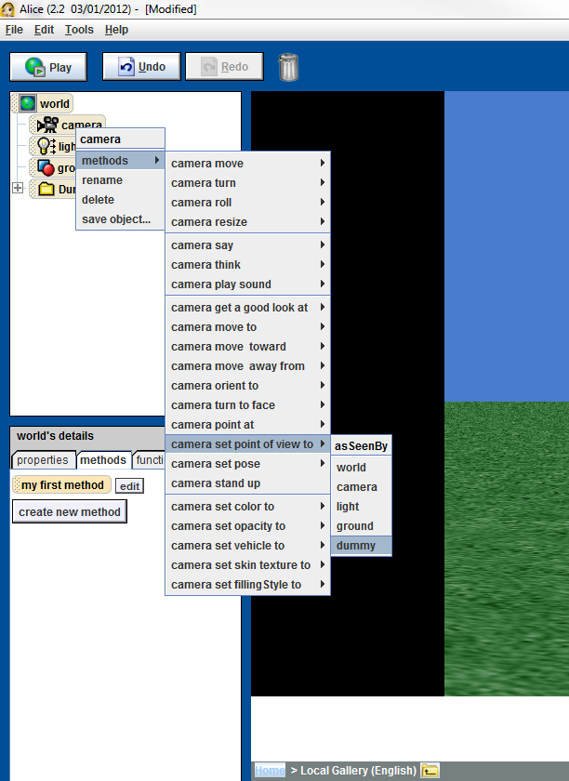
Step 8: Return The Camera to the Initial Position
This step is to familiarize the student with navigating the Alice world. If you ever loose you place in your Alice world while manipulating your Alice scene, you can always find your way back to the initial camera position by taking the following steps.
Find the Object Tree on the upper left corner of the Alice program.
Right click on the Camera object under the Object Tree.
Find, and move your mouse over, the “methods” option for the camera object.
Find, and move your mouse over, the “camera set point of view to” option.
Find and left click on the “dummy” object.
Notes:
Before having the students take steps 6.a to 6.e, have them play with the arrow keys to move about their world.

Slide 15
Notes:
Lock Floor(Ground)
Slides Required
isFirstClass of ground properties to false

